Slide 1
Cognitive Service Integrate with Power BI
Caspar Chou
v-caspch@microsoft.com

Slide 2
Download Slides
https://aka.ms/fpg_workshop

Slide 3






Integration
Cognitive Service
business intelligence
Sensors
Azure SQL Database
Device
Apps
IoT Hub
Stream
Analytics
Power BI

Slide 4

Cognitive Service
Face API

Slide 5
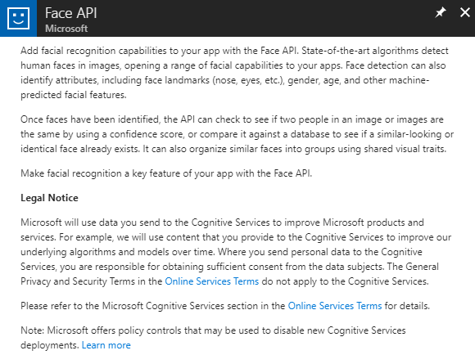
Create Face API
Once faces have been identified, the API can check to see if two people in an image or images are the same by using a confidence score

Slide 6
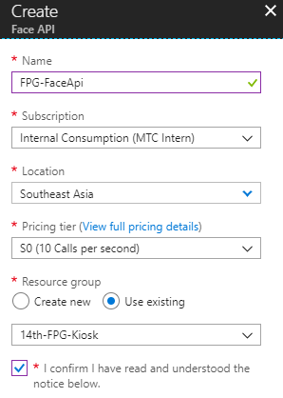
Create Face API
Configure Settings
Configure Settings

Slide 7

Data Service
IoT Hub
Stream Analytics job
SQL Server

Slide 8
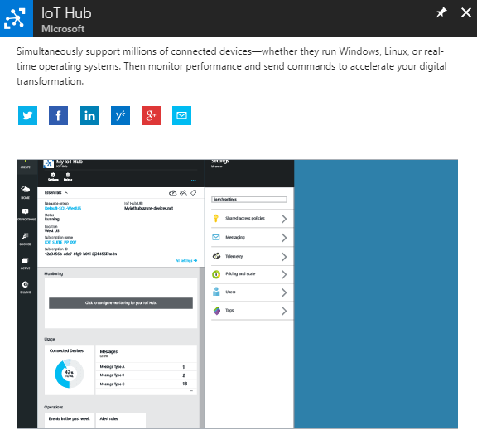
Create IoT Hub
Provides multiple device-to-cloud and cloud-to-device communication options. These options include one-way messaging, file transfer, and request-reply methods.

Slide 9
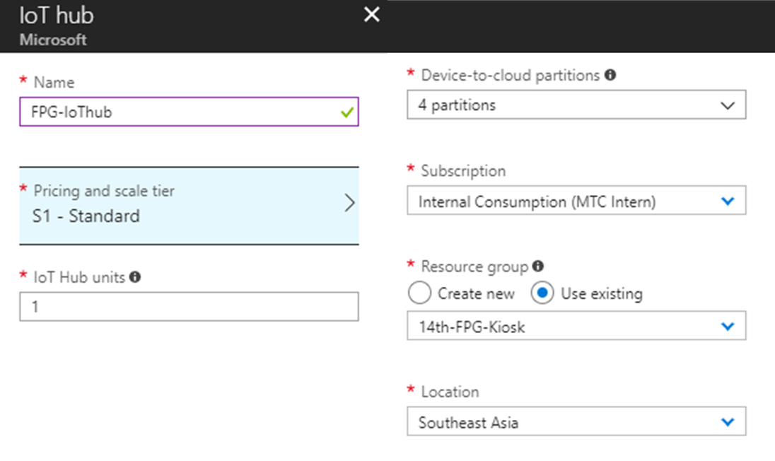
Configure IoT Hub Settings
Configure Settings

Slide 10
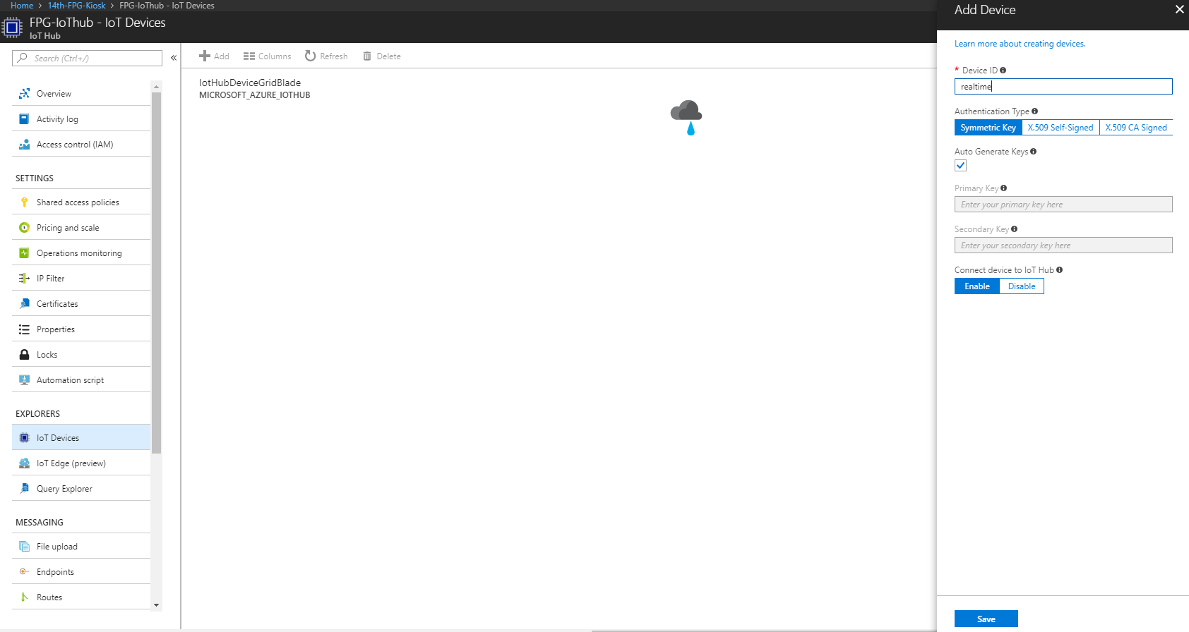
IoT Device
Add a new

Slide 11
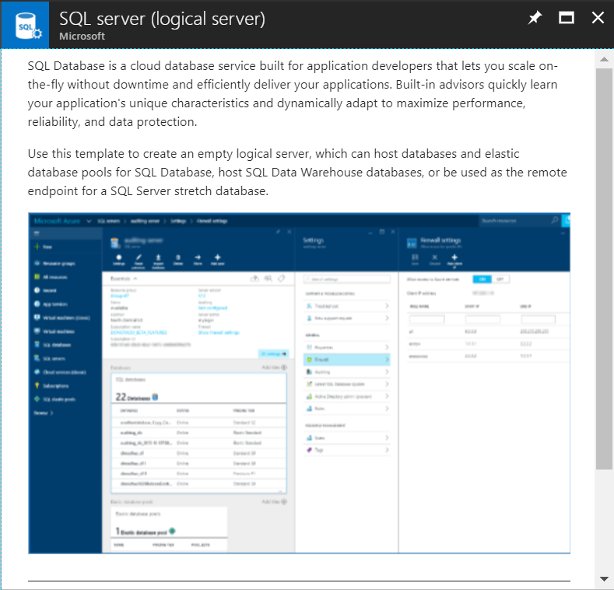
Create SQL Server
SQL Database is a cloud database service built for application developers that lets you scale on-the-fly without downtime and efficiently deliver your applications.

Slide 12
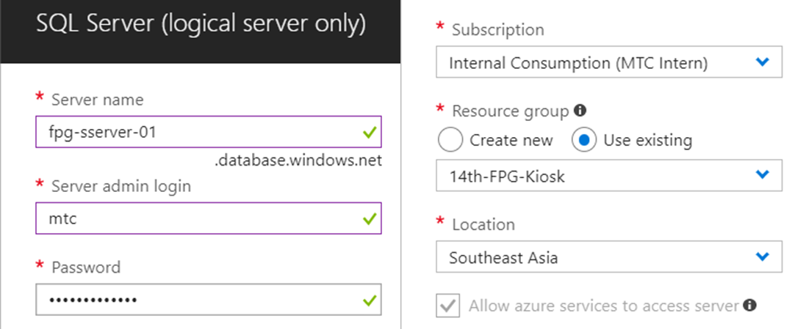
Setting SQL Server Account
Setting admin account & Southeast Asia location

Slide 13
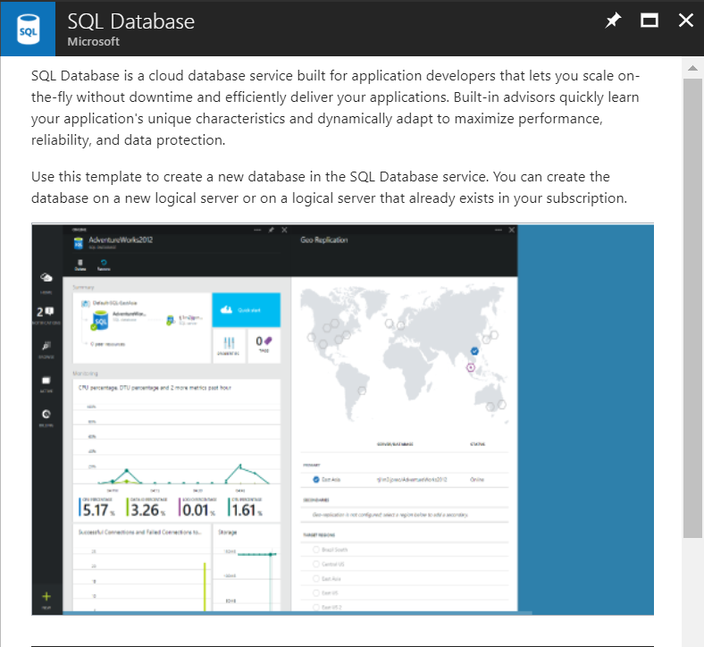
Create SQL Database
SQL Database is a cloud database service built for application developers that lets you scale on-the-fly without downtime and efficiently deliver your applications.

Slide 14
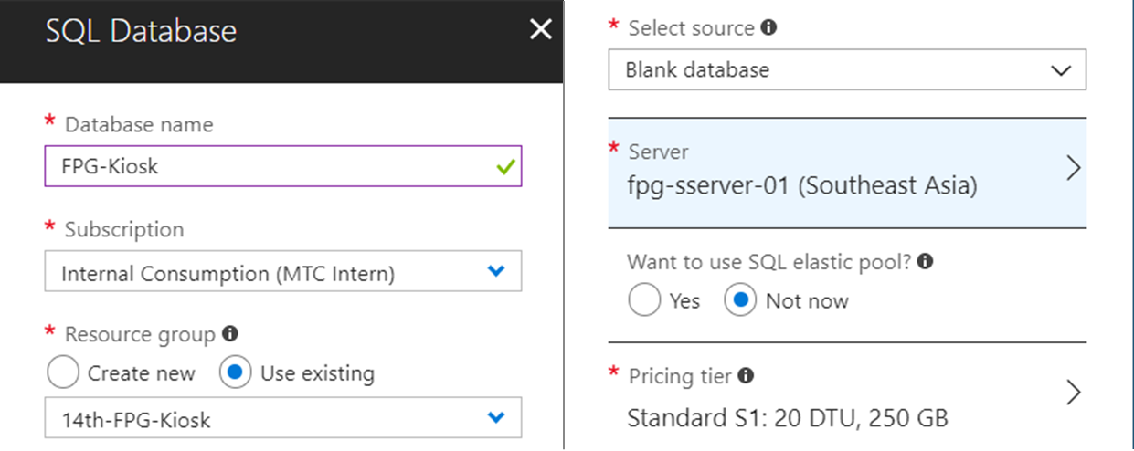
Create SQL Database
Setting server

Slide 15
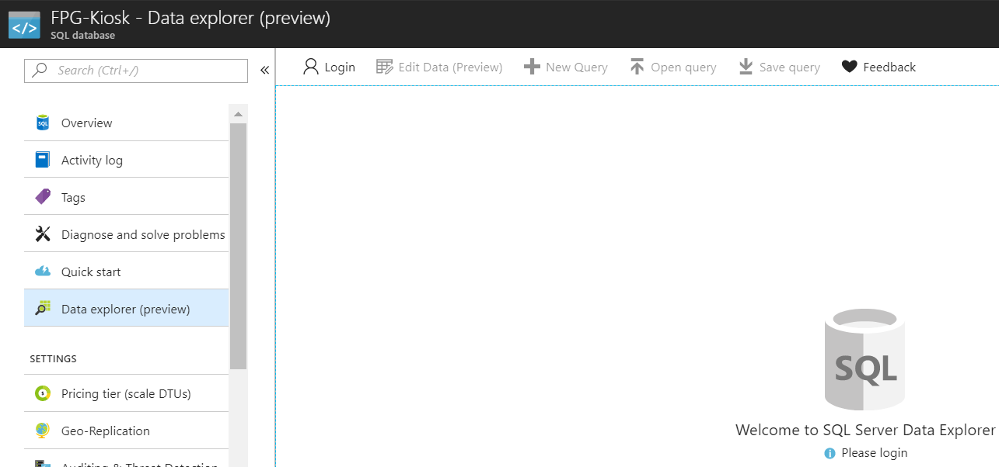
Login into SQL Server

Slide 16
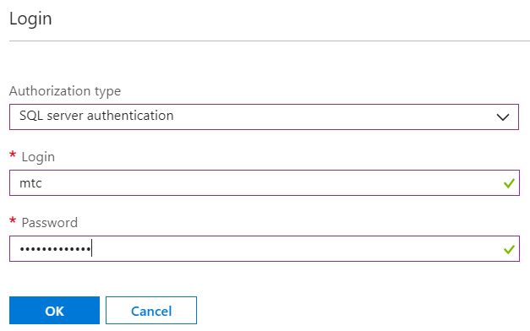
Login into SQL Server

Slide 17
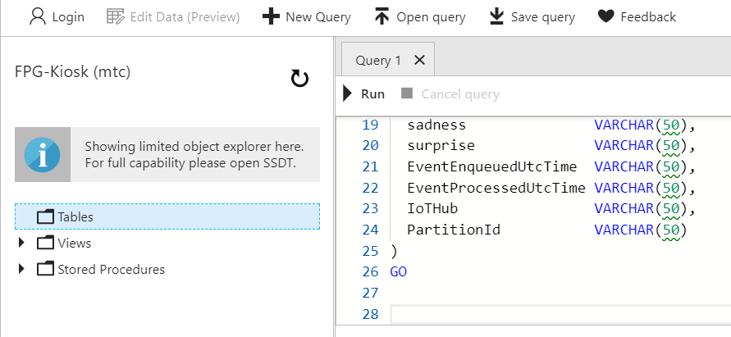
Paste SQL Code
Using the code which in the following link
https://aka.ms/IntelKiosk_SQL

Slide 18
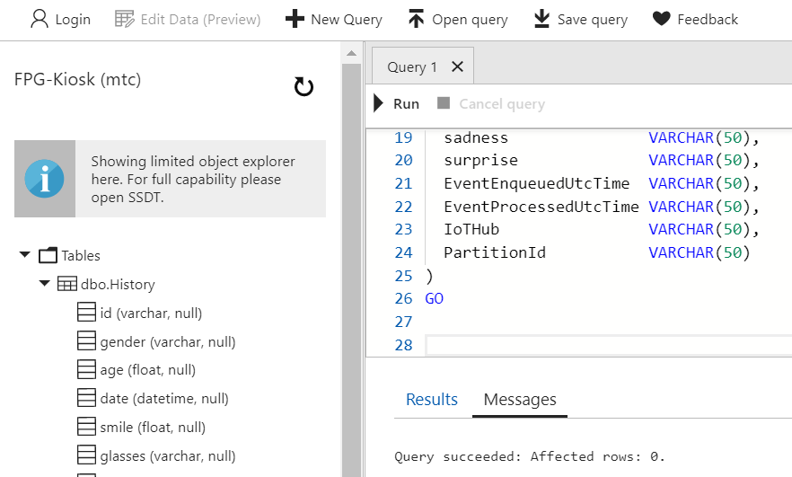
Reload & Check

Slide 19
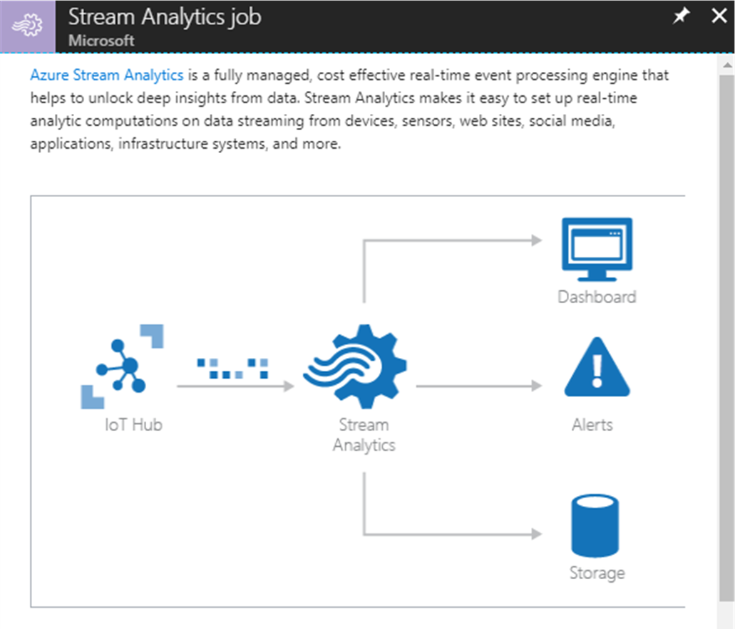
Create Stream Analytics Job
Azure Stream Analytics is a fully managed, cost effective real-time event processing engine that helps to unlock deep insights from data

Slide 20
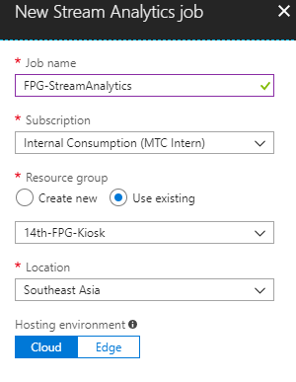
Configure Stream Analytics Job

Slide 21
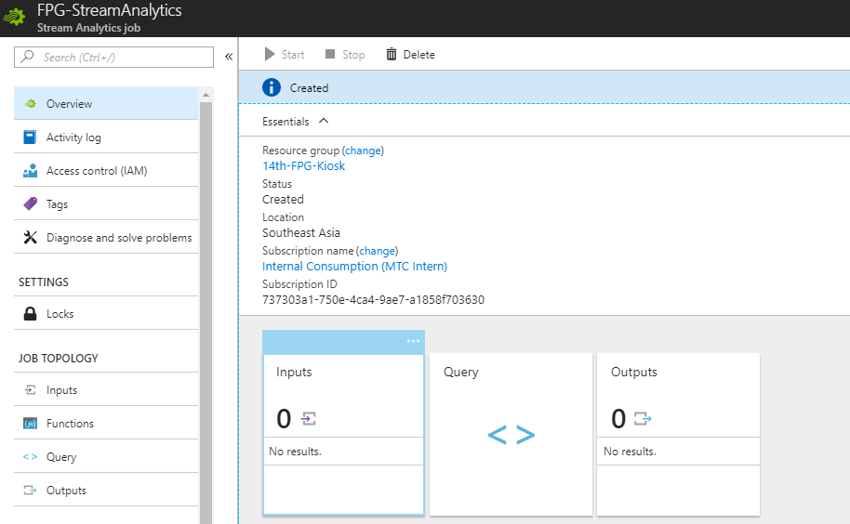
Setting Stream Analytics Job Inputs

Slide 22
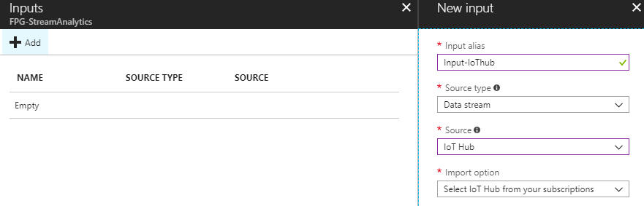
Add a new input from IoT Hub

Slide 23
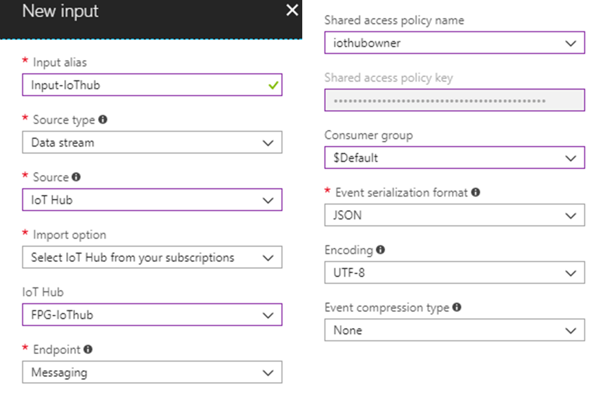
Setting Input Source

Slide 24
Setting Stream Analytics Job Outputs

Slide 25
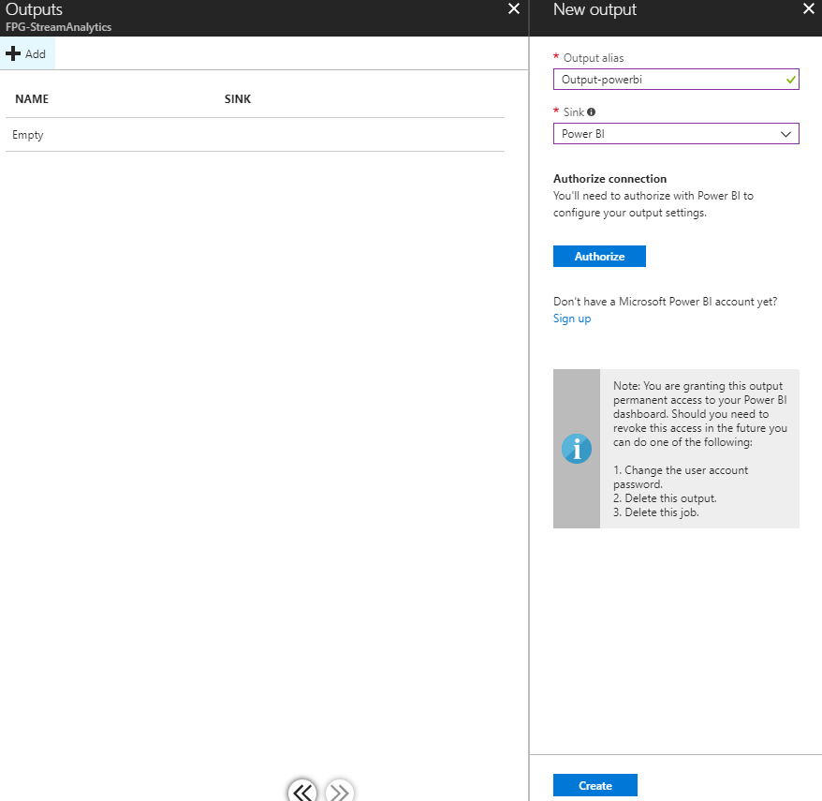
Create Stream Analytics Job
Configure Settings

Slide 26
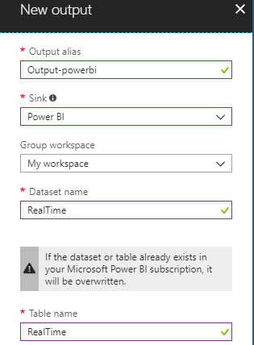
Setting Output to Power BI (Optional)

Slide 27
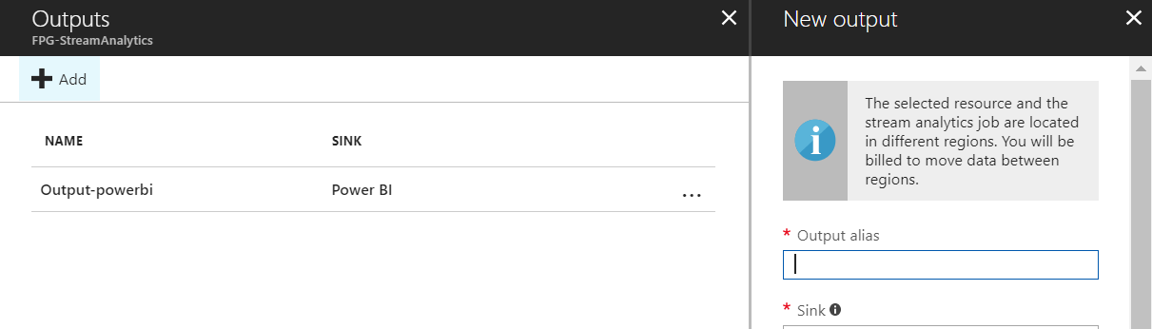
Add a new output to SQL Server

Slide 28
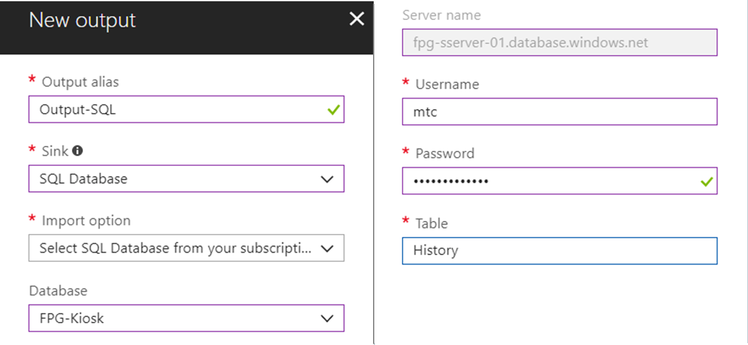
Setting Output to SQL Server

Slide 29
Setting Stream Analytics Job Query

Slide 30
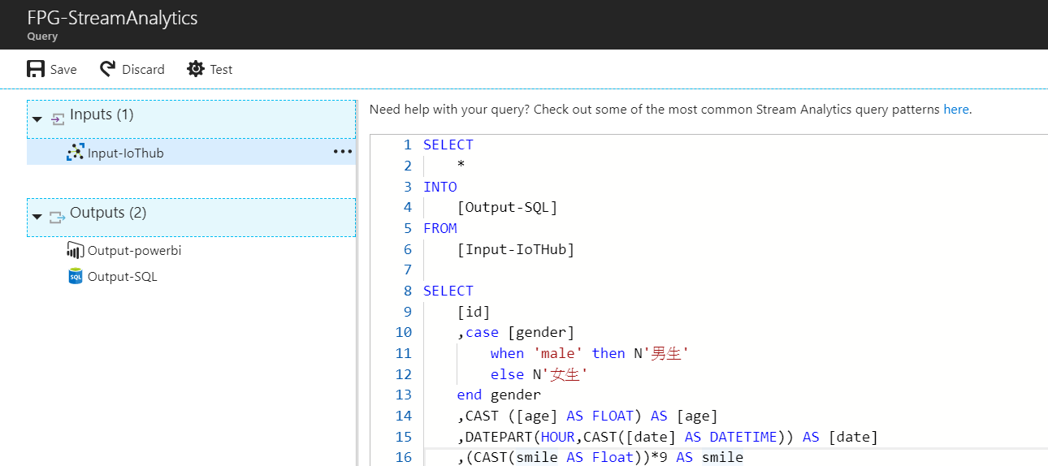
Setting Query
https://aka.ms/IntelKiosk_SA

Slide 31
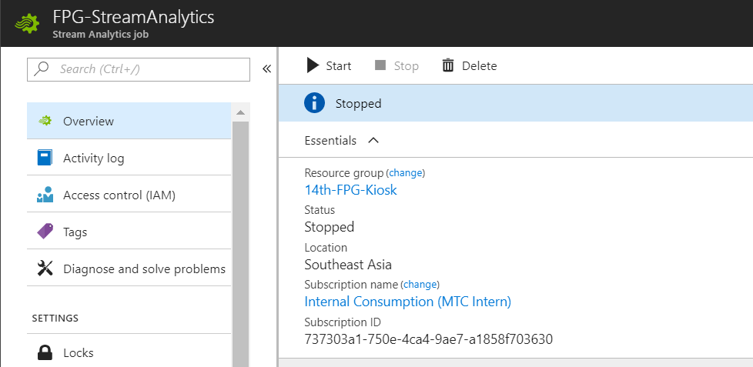
Enable Stream Analytics Job

Slide 32

Download Intelligent Kiosk Sample
https://aka.ms/IntelKioskSample

Slide 33
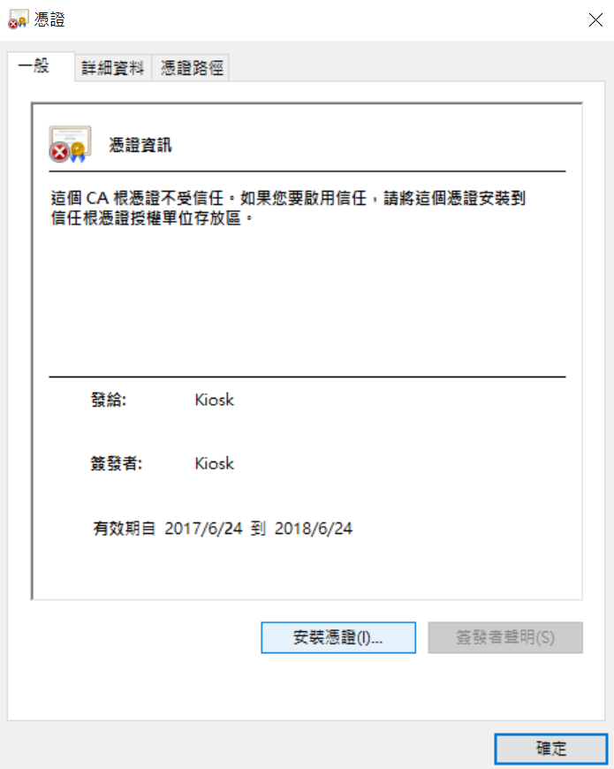
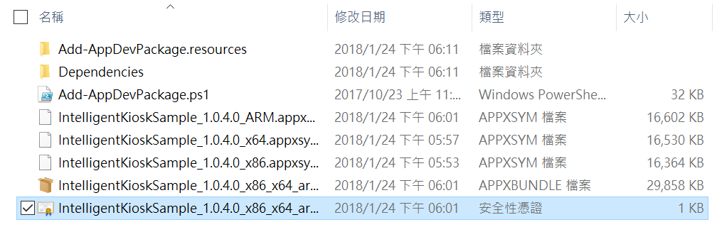
Install Certificate

Slide 34
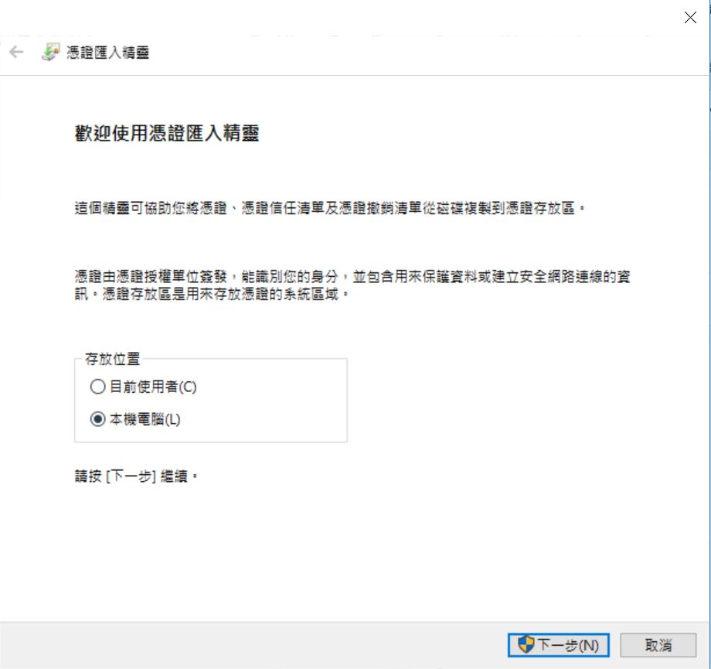
Select Local Machine

Slide 35
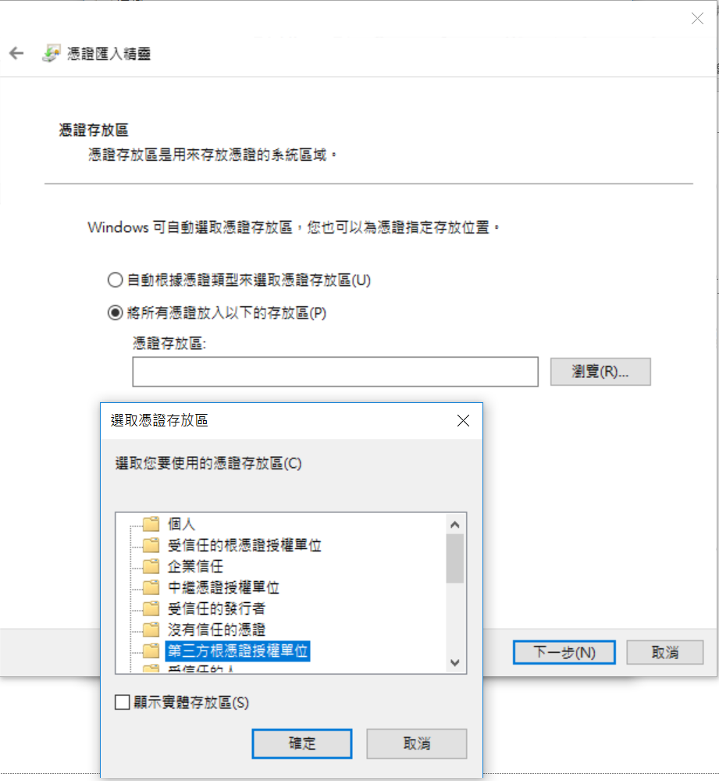
Select Third-Party Root Certification

Slide 36
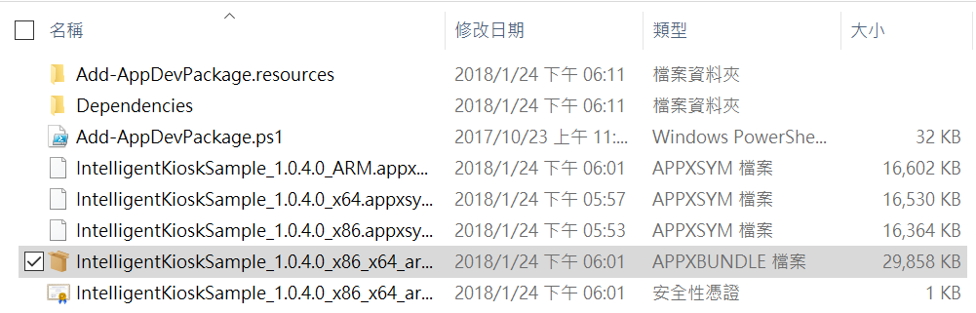
Install Intelligent Kiosk Sample

Slide 37
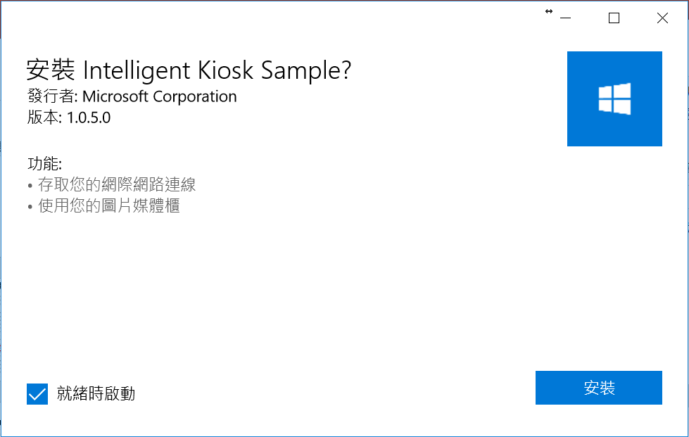
Install Intelligent Kiosk Sample

Slide 38
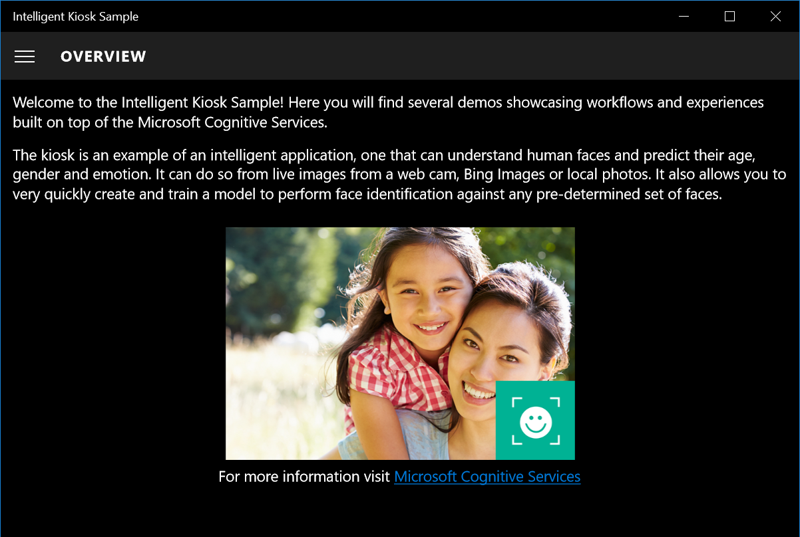
Launch Intelligent Kiosk Sample

Slide 39
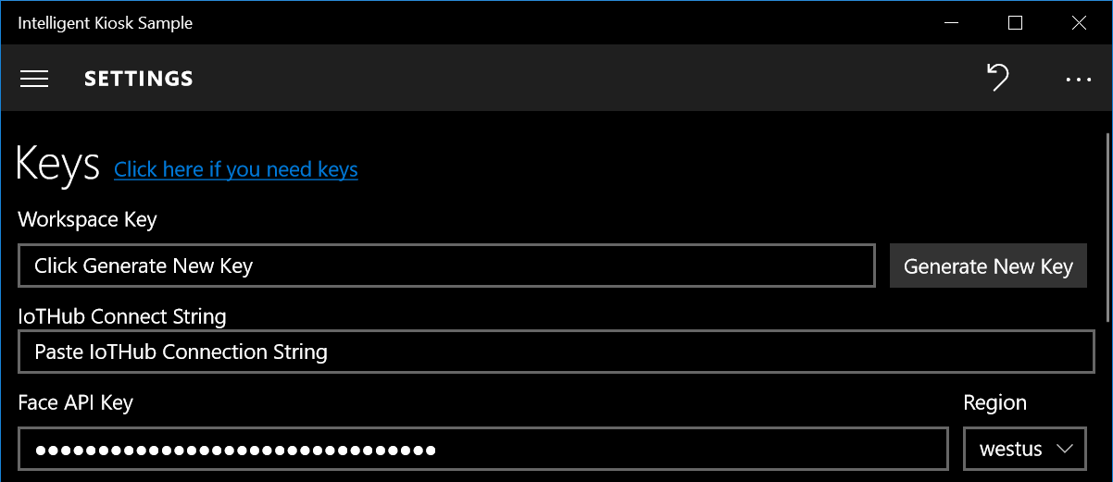
Setting API Keys

Slide 40
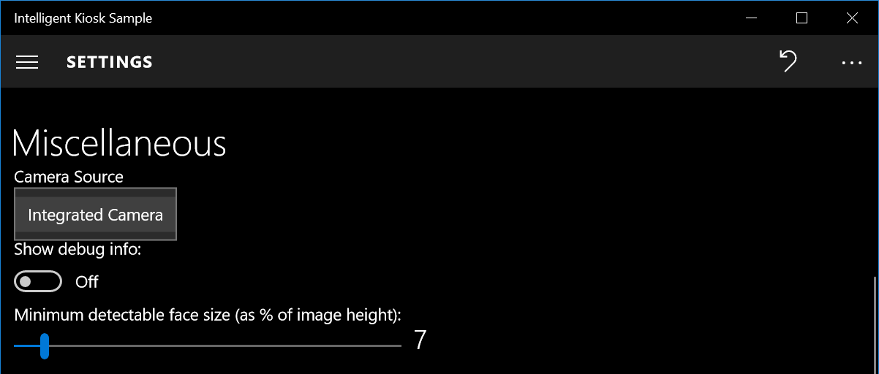
Setting Camera

Slide 41
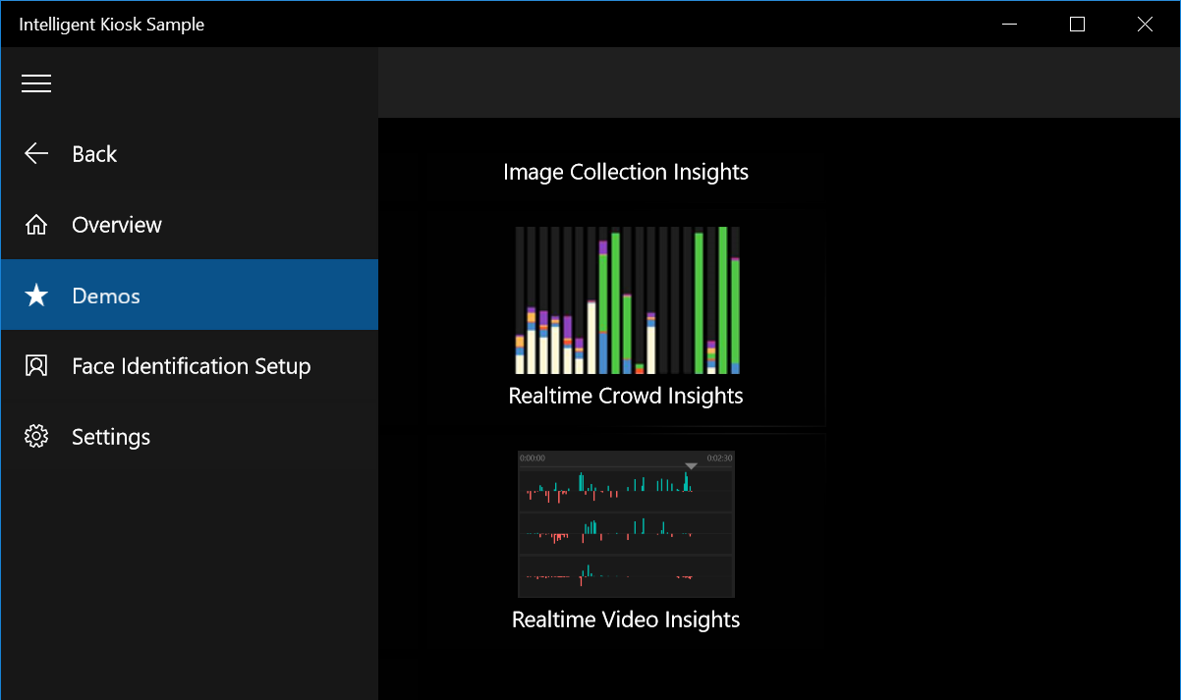
Launch Demo

Slide 42
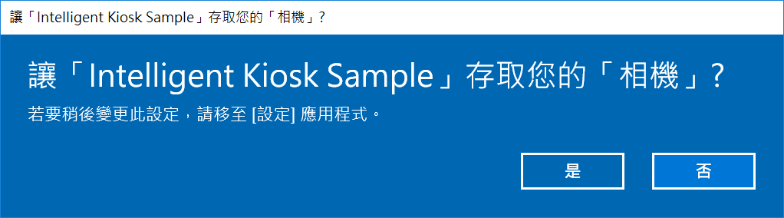
Allow Permission

Slide 43
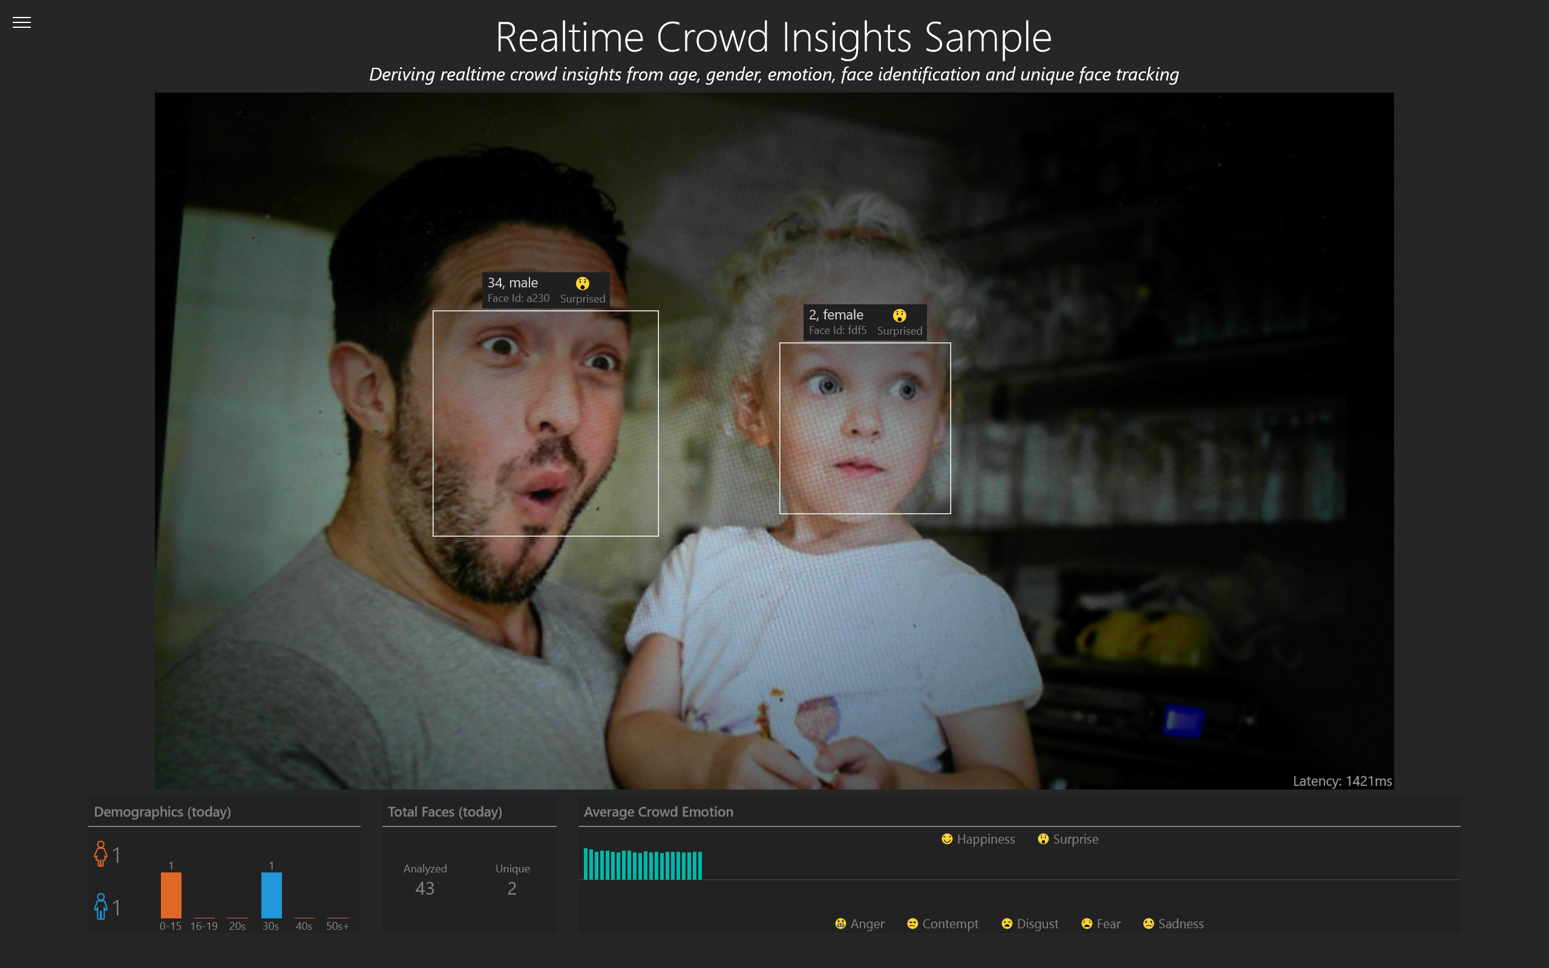
Demo

Slide 44

Power BI
Install Power BI
Publish Model

Slide 45

Download Power BI Desktop Document
https://aka.ms/IntelKiosk_BI

Slide 46
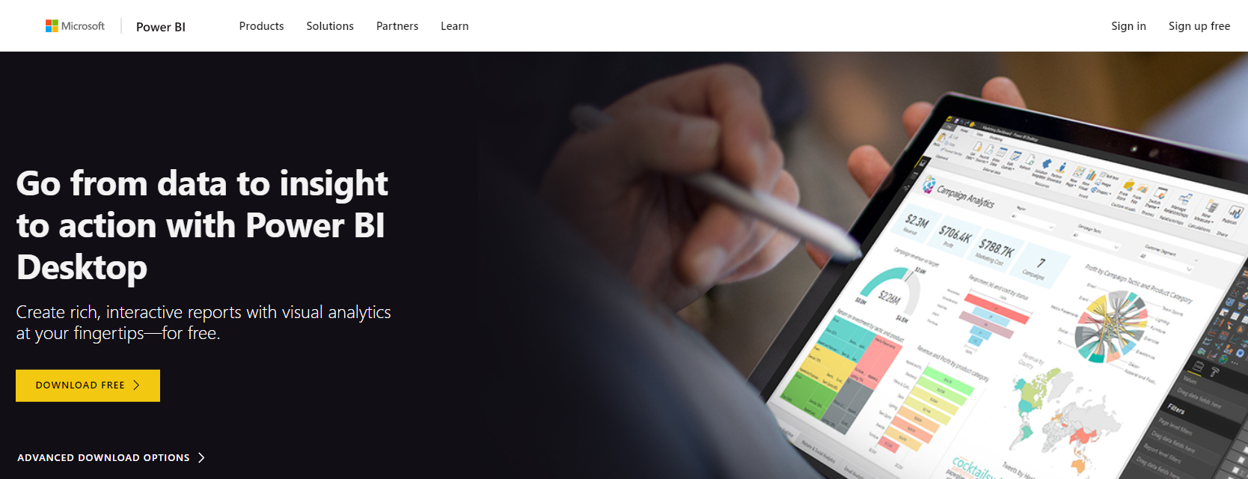
Download Power BI Desktop
https://aka.ms/download_powerbi

Slide 47
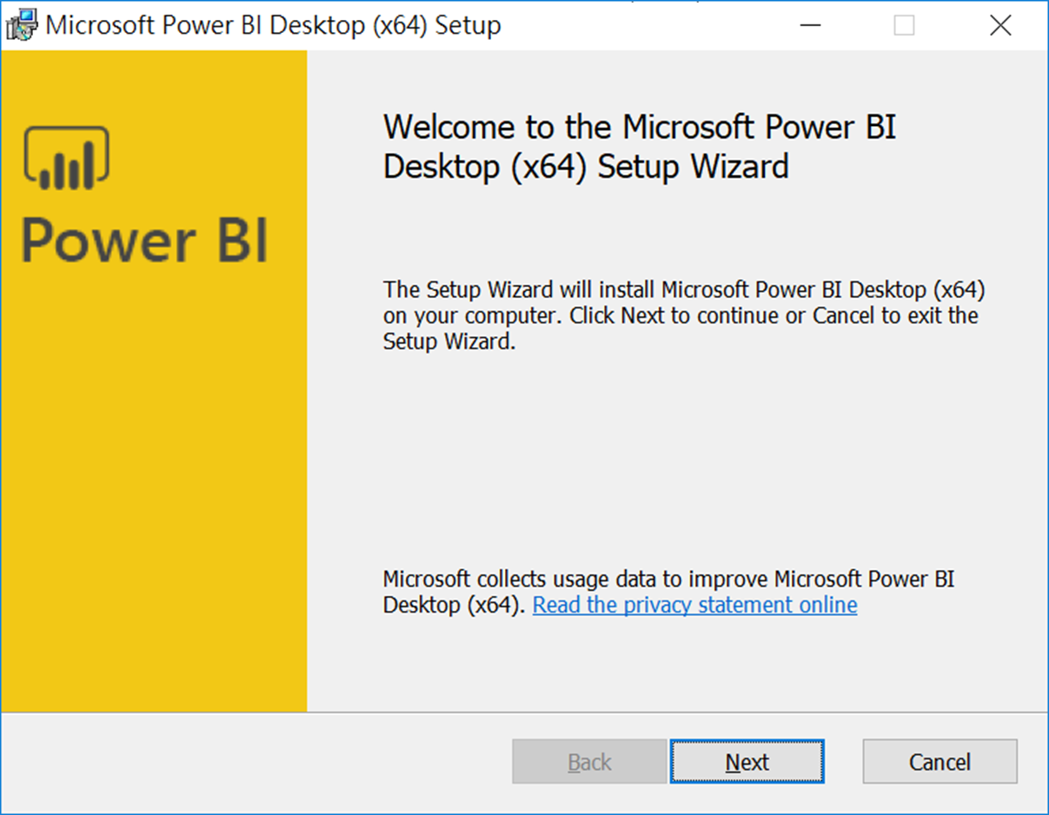
Install Power BI Desktop

Slide 48
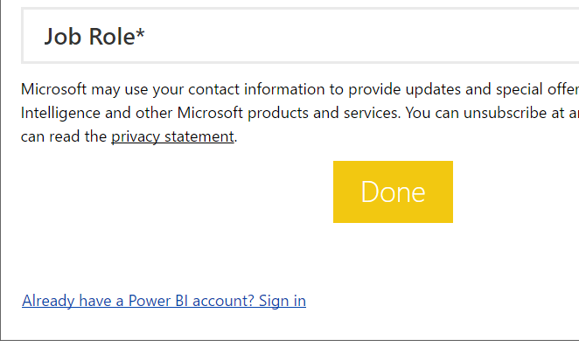
Click Sign In Link

Slide 49
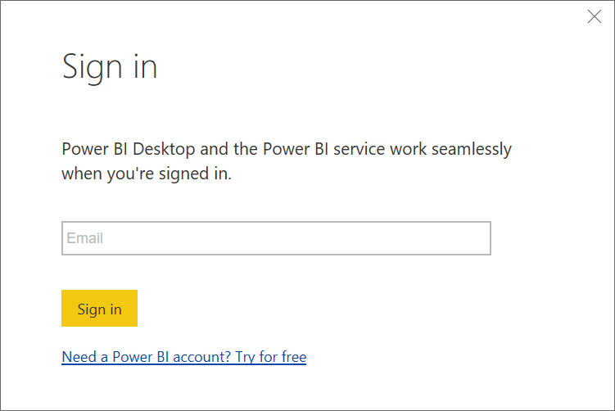
Login into Power BI

Slide 50
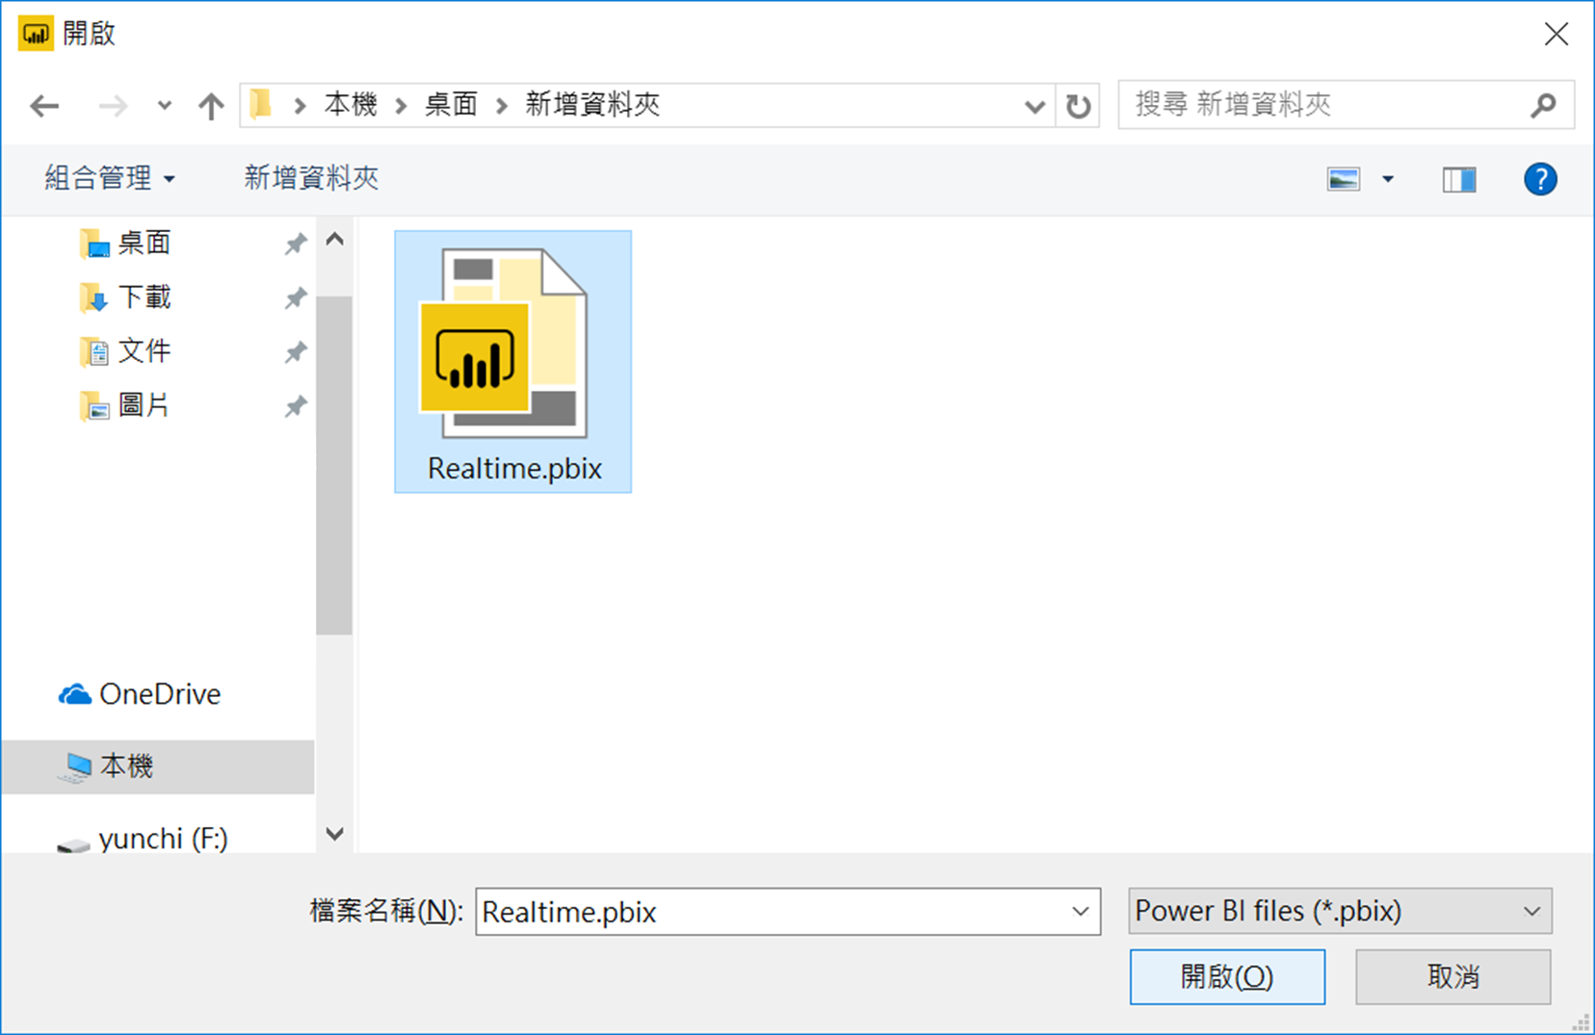
Open Realtime File

Slide 51
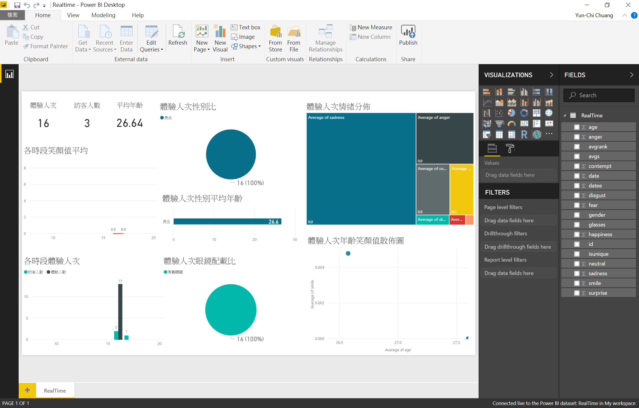
Power BI

Slide 52
Publish Model

Slide 53
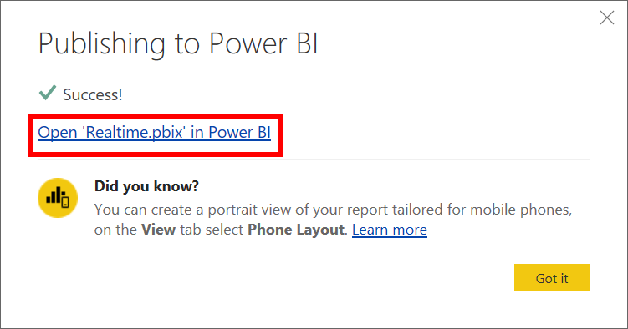
Create Stream Analytics Job
Configure Settings

Slide 54
Source Code
https://aka.ms/IntelKiosk_src

